Slide 1
Healthcare Science Key Stage 2

Slide 2
Activity 1
Who works at a football club?
Notes:
Generate interest asking if anyone likes football and who they support etc.
You might be wondering why we are talking about football well all organisations have a workforce including football clubs. We’d like you to think about all the different jobs which happen in a football club, think about the physical building, who looks after the players, events that might take place and who’s on hand on match day. Think about how the club promotes itself too!

Slide 3
Activity 2
Who works in a hospital?
Notes:
Ok so with your list of job roles at the football club let’s see how many of them happen in a hospital or elsewhere in the NHS?
Write down 10 other job roles that only happen in a hospital, I’ll give you an example neurosurgeon – a brain doctor.

Slide 4
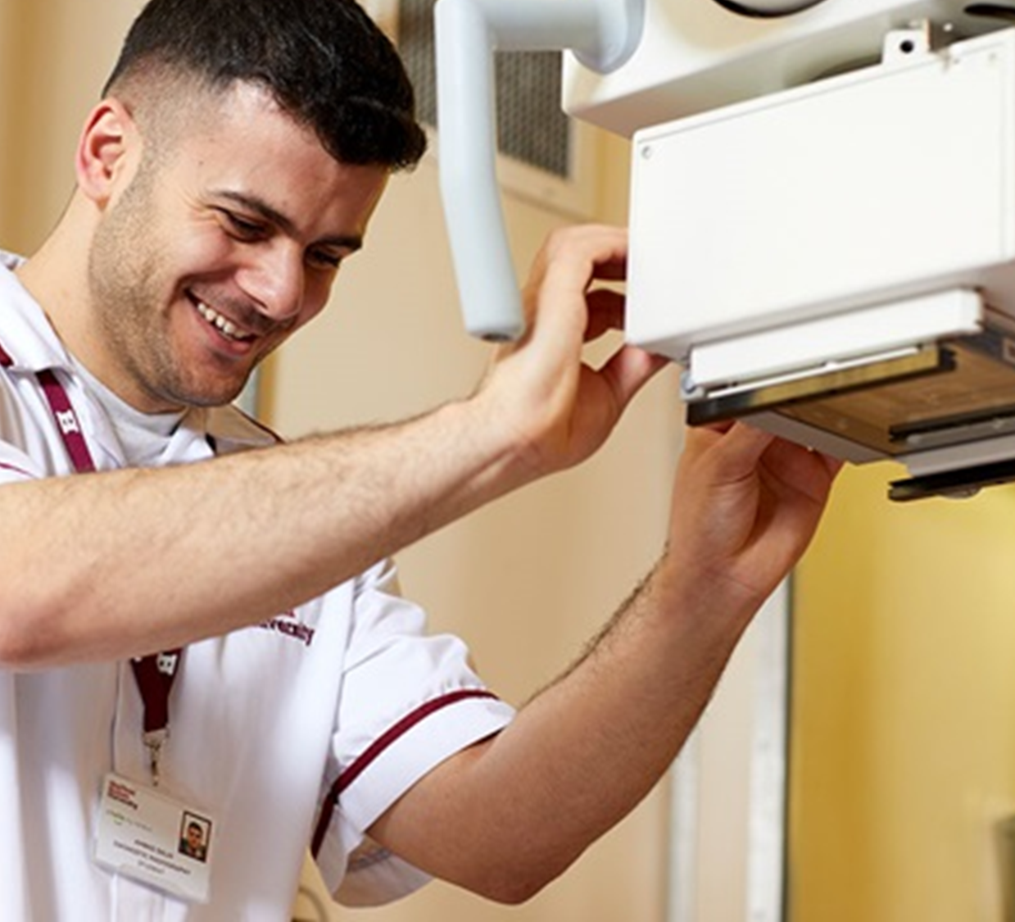
Activity 3
Guess the radiology image
Notes:
People have all sorts of investigations when they come into hospital and some of these are done by our healthcare science team including sonographers like Hayley and Allied Health Professions such as radiographers like the job holder in the picture.
Let’s take a look at an XRAY can you describe what has happened?

Slide 5
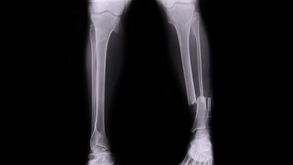
Notes:
Tibia and fibular

Slide 6
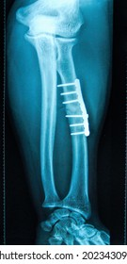
Notes:
Plate and pins

Slide 7
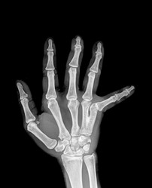
Notes:
dislocation

Slide 8
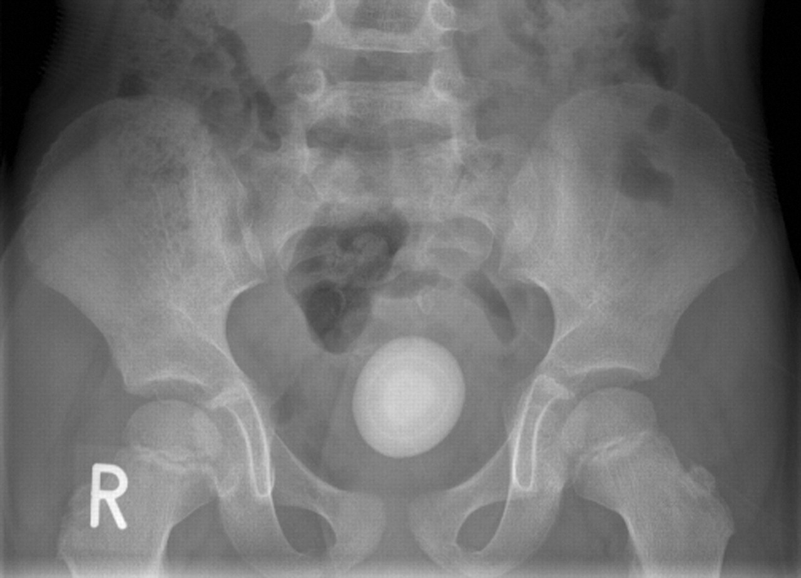
Notes:
Bladder stone (pearl analogy)

Slide 9
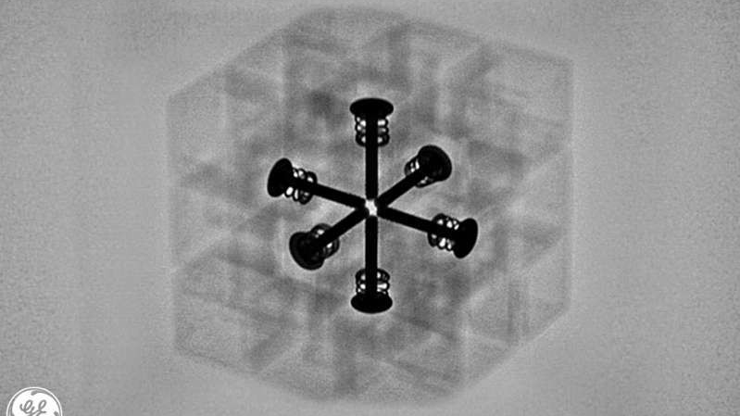
Notes:
Rubiks cude

Slide 10
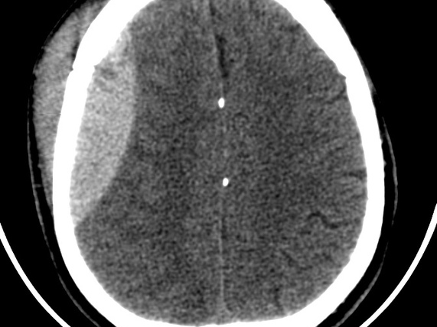
Notes:
CT Brain after RTA

Slide 11
Notes:
cauliflower

Slide 12
Notes:
Infected hip replacement (X-ray and nuclear med)

Slide 13
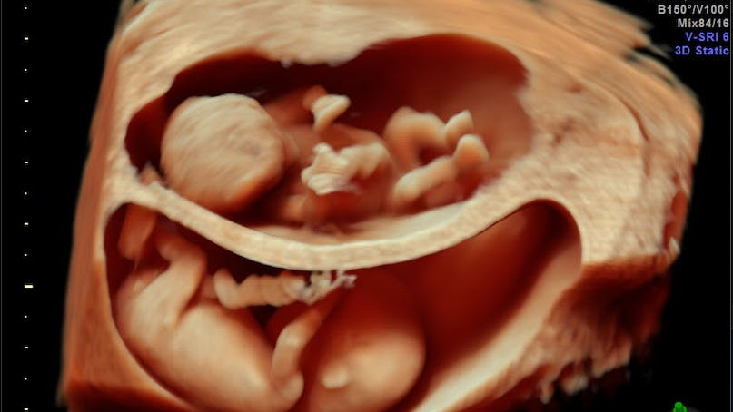
Notes:
twins

Slide 14
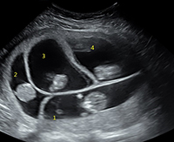
Notes:
quads

Slide 15
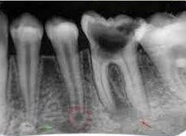
Notes:
Tooth cavity

Slide 16
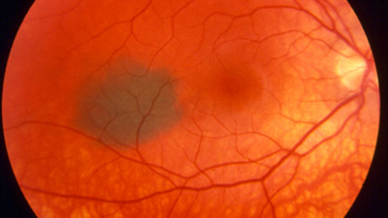
Notes:
Freckle back of eye

Slide 17
Any Questions?

